Slide 1





Stock Market Forecasting through Sentiment Analysis
Guide: Dr. P. Swetha
Department of CSE, JNTUH

Slide 2
Problem Statement
Traditional stock forecasting models fail during market volatility.
Breaking news and investor sentiment drive unpredictable price movements.
Existing models ignore real-time sentiment influence.

Slide 3
Objectives
Implement an LSTM-based time series model.
Extract real-time sentiment from financial news using FinBERT.
Combine quantitative price data with qualitative sentiment.
Visualize live predictions via a Flask dashboard.
.

Slide 4
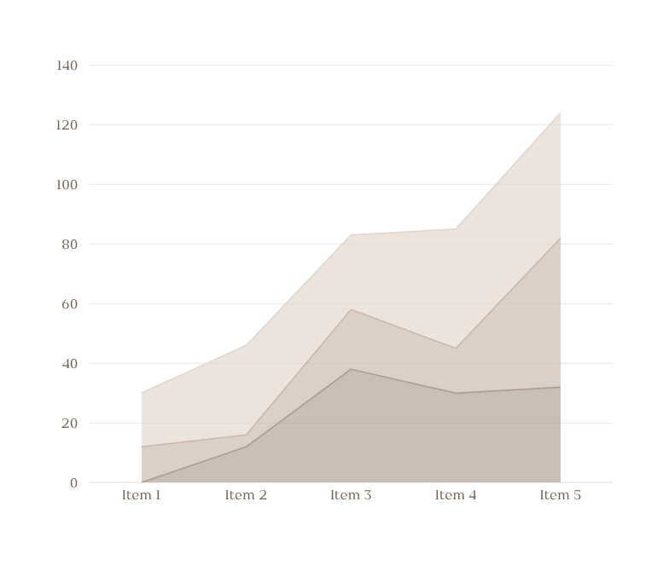
Literature Insights
Das et al. (2021): Twitter sentiment for stock forecasting.
Xu & Keselj (2019): CNN-LSTM hybrid for news sentiment.
Liu et al. (2022): FinBERT outperforming generic models.
Farimani et al. (2024): Multimodal forecasting in volatile markets.

Slide 5
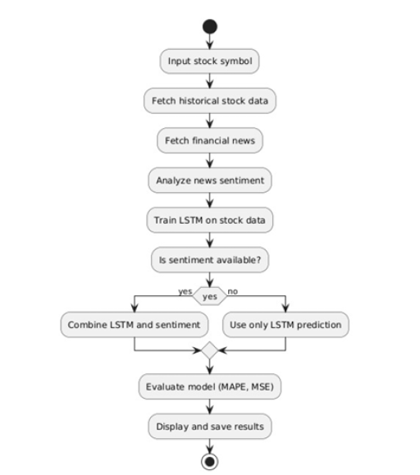
System Architecture

Slide 6
Methodology
Data Sources: Yahoo Finance API (stock & news).
Sentiment Classification: FinBERT (Positive, Neutral, Negative).
Time Series Prediction: LSTM (60-day lookback window).
Adjustment Mechanism: Forecast tweaked based on sentiment.

Slide 7

Implementation Details
Libraries and Tools:
yfinance, pandas, numpy, tensorflow, transformers, FinBERT, NLTK
VSCode, Flask, Selenium, BeautifulSoup.
Model Parameters:
LSTM: 3 layers, 200/150 units, Adam optimizer
FinBERT: Pre-trained via Hugging Face transformers.

Slide 8
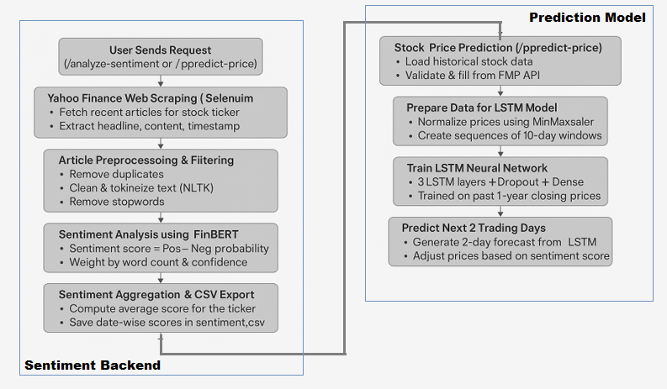

Slide 9
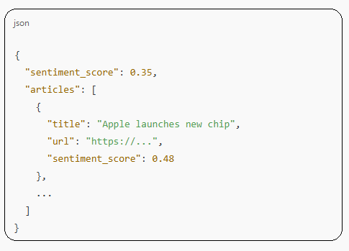
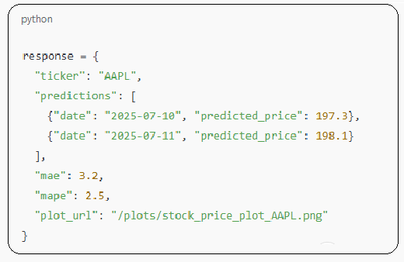
Sample Representation of Output

Slide 10
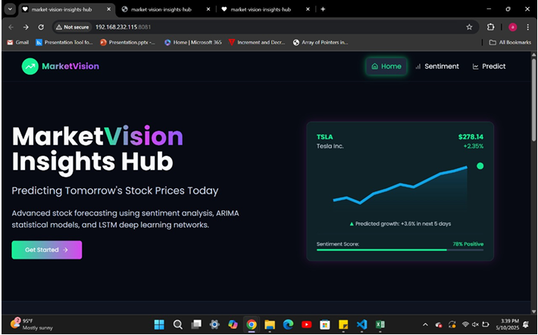
Dashboard Overview

Slide 11
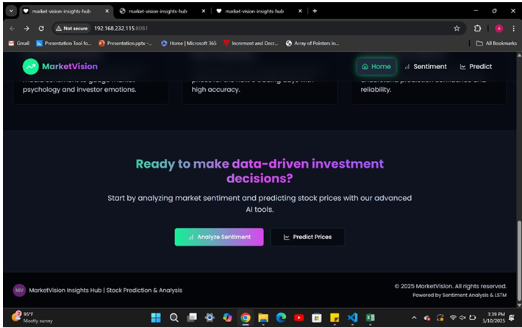

Slide 12
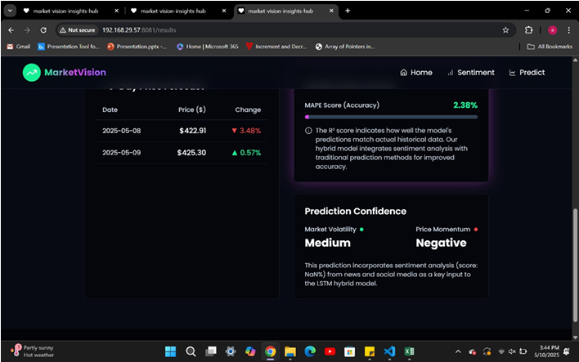

Slide 13
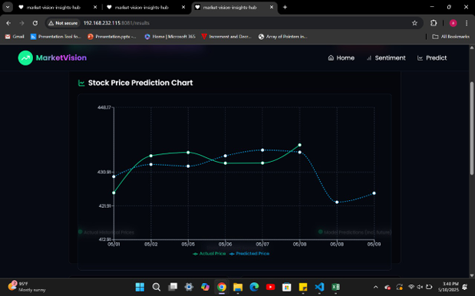

Slide 14
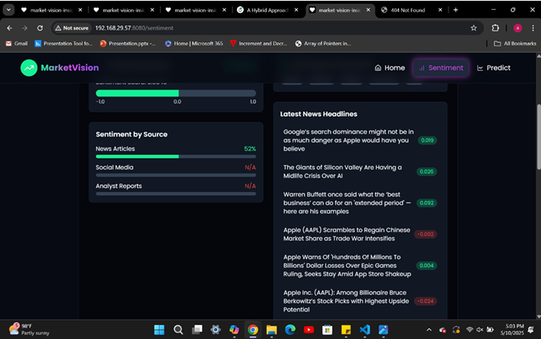

Slide 15
Results
LSTM-only model: High accuracy, but lacks real-time adaptability.
Hybrid model:
Improved accuracy on volatile days.
Example: AAPL → 4.1% MAPE improvement
TSLA during earnings week → 5.5% better prediction.

Slide 16
Conclusion
Hybrid models outperform traditional numeric-only models.
Sentiment analysis adds meaningful context for real-time forecasting.
Practical application via Flask dashboard supports investor decisions.

Slide 17
Thank You So Much

